Slide 1
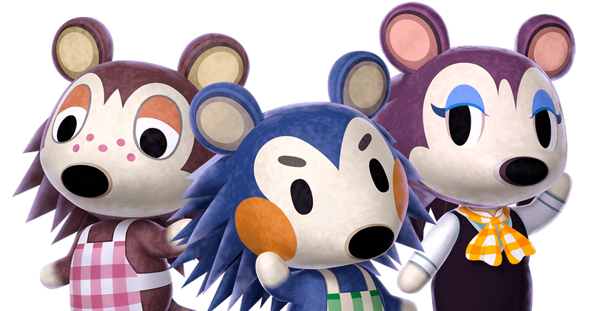
Animal Crossing Outfits: Price, Color, and Resale Value
Ryan Tran, Adam Tschida, Dara Zwemer, Colby Luttrell

Slide 2
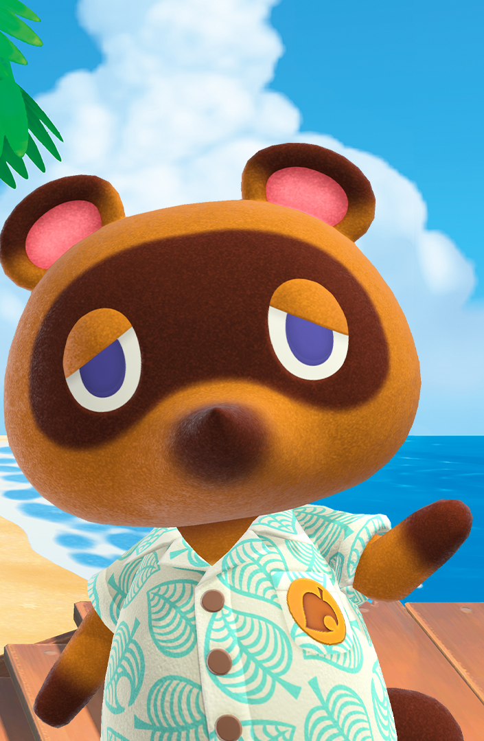

Background and Importance
From the most recent game (New Horizons)
Before the most recent update
Premise: You move to an island and can purchase a better house, clothes, etc. from Tom Nook, owner of Nook Inc.
Actual time and season affects gameplay
Clothes purchased mainly with Bells
1 Bell = 1 Yen
1 USD = 114 Yen = 114 Bells
Analyzed tops, bottoms, headgear, and shoes
Vendors: Able Sisters, Kicks, Nook Shopping Catalog, etc.
Some have multiple color variations
Price and resell value important.
Limited storage space at the beginning of the game
Objective is to repay debts to Tom Nook.

Slide 3
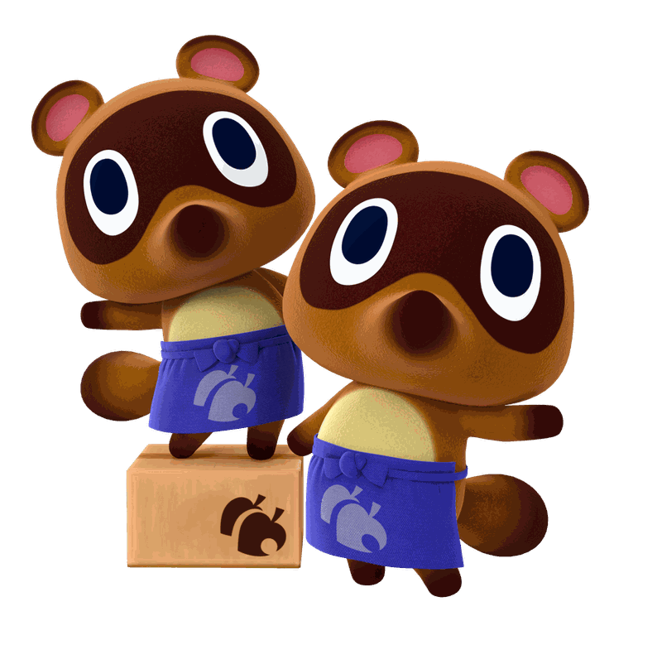
Main Conclusions
Outfit Price Values:
Some significant features but no clear patterns behind buy price variation
Resale Values:
Flat, ubiquitous 25% resale rate for all items
Dominant Colors:
Dominant: Blue, Green, and Red
Secondary: Black and White
Seasonal Clothes:
Year-round items and tops are most common
More Summer items than Winter items
Year-round clothes are more expensive overall
Similar dominant colors in Winter and Summer clothes

Slide 4
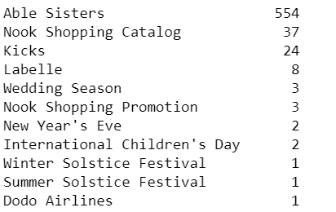
Our Sample: Vendors
Background:
The Able Sisters store and the Nook Shopping Catalog are accessible from your island each day.
Kicks and other vendors travel to your island on certain days.
Sample:
Able Sisters sells most items
Special festivals and Dodo Airlines promotions provide the fewest items

Slide 5
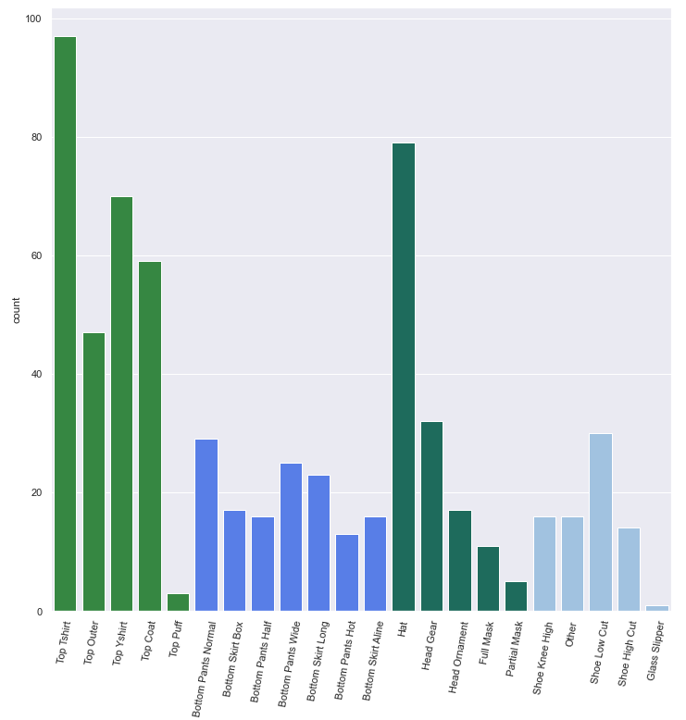
Our Sample: Item Types
Tops were the most common
Single Item Categories:
Tops - 276
Bottoms - 139
Hats/Headgear - 144
Shoes - 77

Slide 6

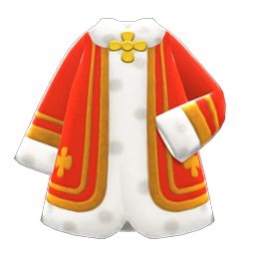
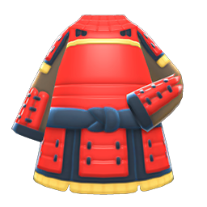
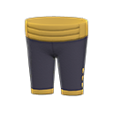
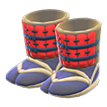
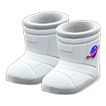
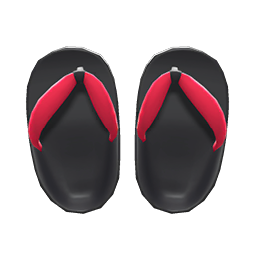
Outfit Values
Most Expensive Outfit
Hat: Royal Crown
1,200,000 Bells
Shirts: Royal shirt or samurai shirt
6,720 Bells
Pants: Noble Pants
4,300 Bells
Shoes: Samurai greaves, space boots, or zori
4,300 Bells

Slide 7

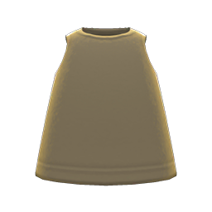
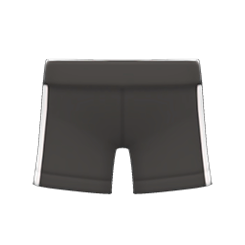
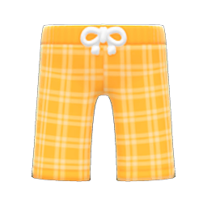
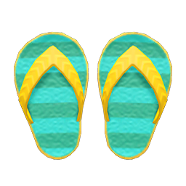
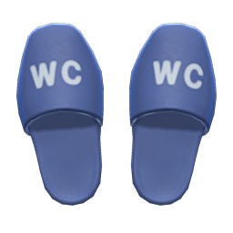
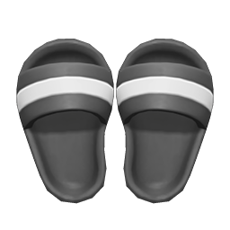
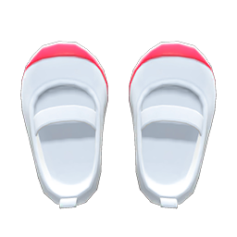
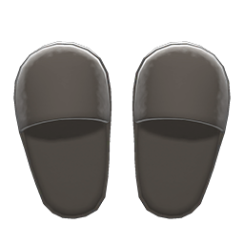
Outfit Values
Least Expensive Outfit
Hats: Paper bag
140 Bells
Shirt: Tank
350 Bells
Pants: Athletic shorts or traditional suteteko pants
560 Bells
Shoes: flip-flops, restroom slippers, shower sandals, slip-on school shoes, or slippers
350 Bells

Slide 8
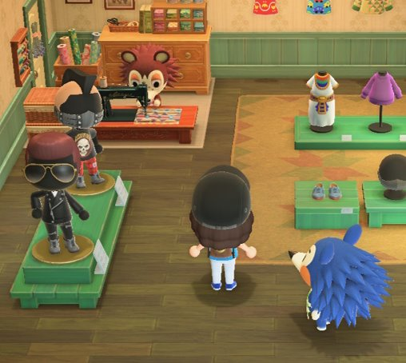
Items with the Highest Resale Value
There were no items that were specifically better resale value. They all sell for 24.86-25%.

Slide 9
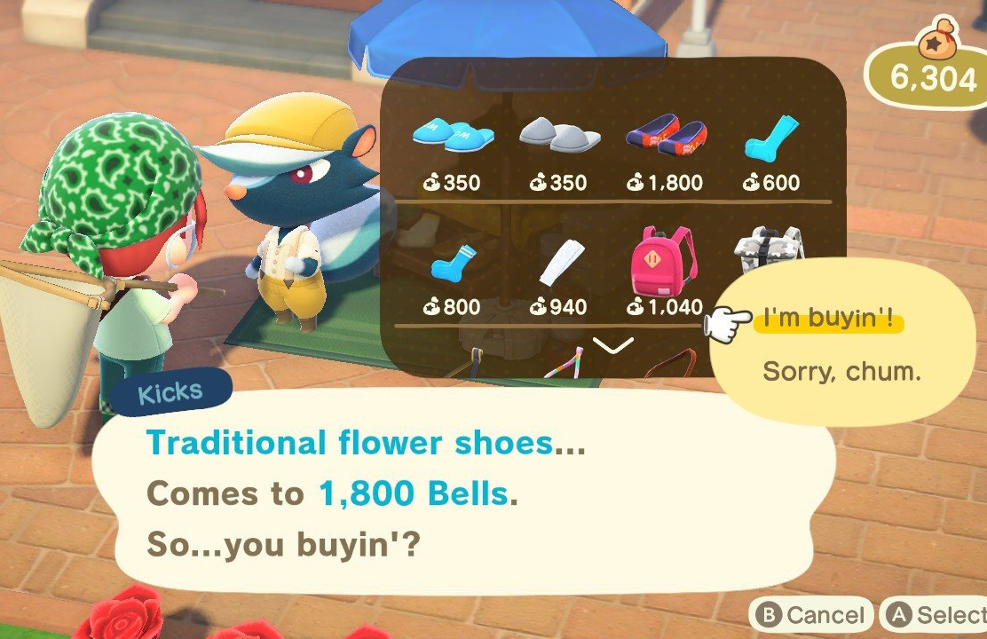
Modeling Buy Price
Initial target variable was resale value
Resale value 25% of buy price across all items
New target variable is the amount each item costs (buy price)

Slide 10
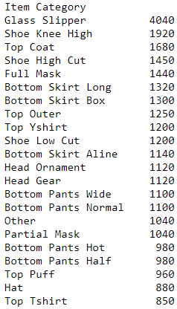
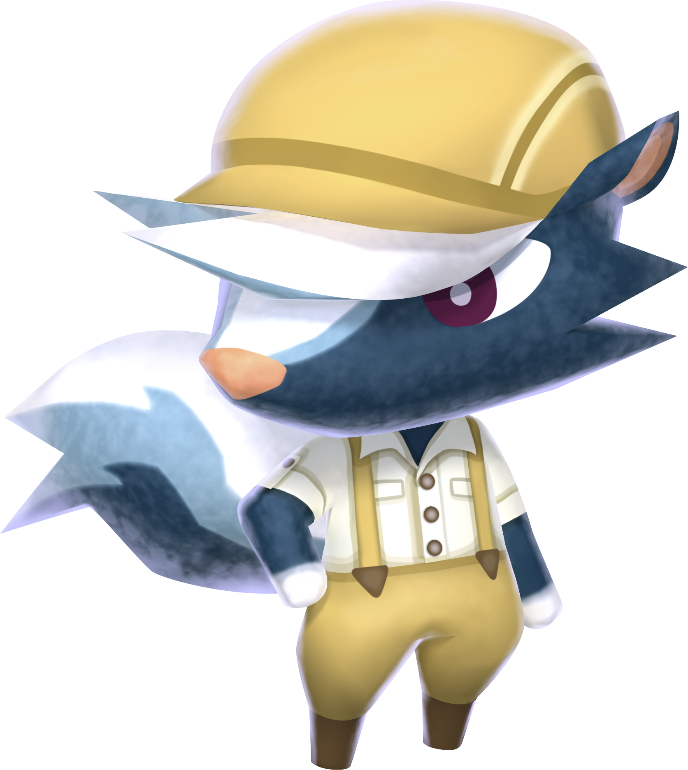
Modeling Buy Price – Initial Groupby
Grouped by item category
Reflective of mean buy price

Slide 11
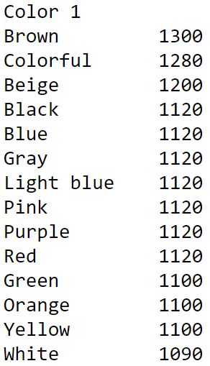
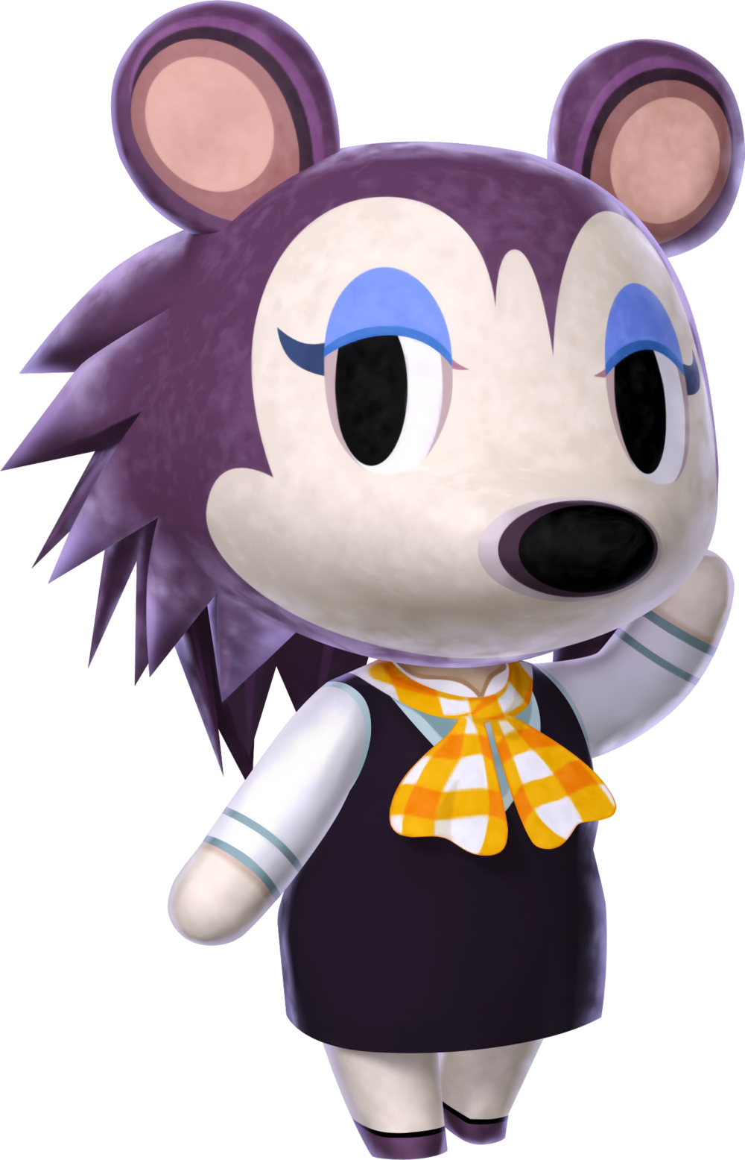
Modeling Buy Price – Initial Groupby
Grouped by primary color
Reflective of mean buy price

Slide 12
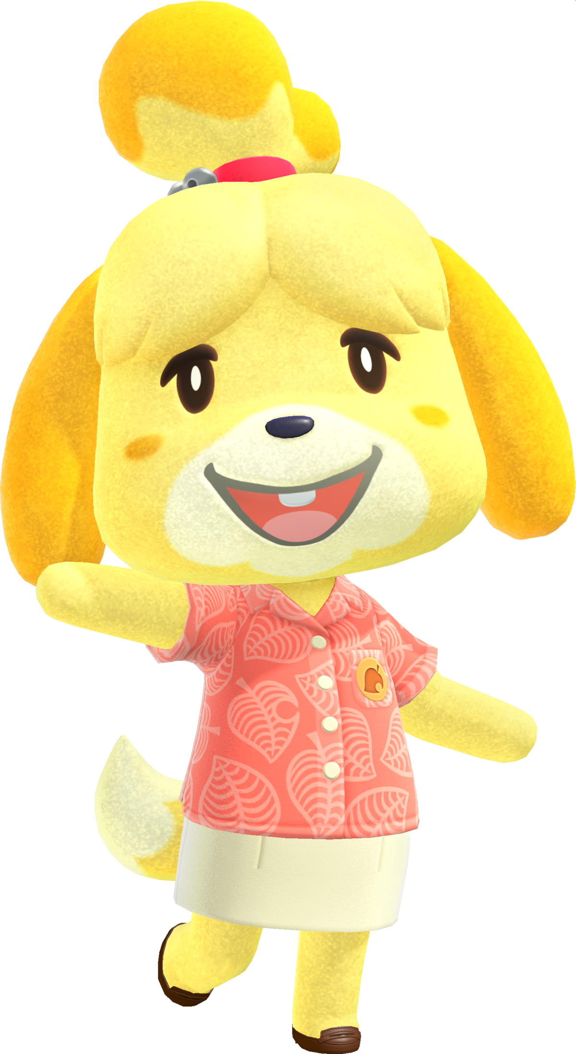
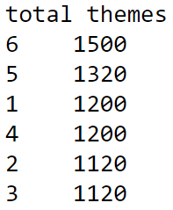
Modeling Buy Price – Initial Groupby
Grouped by count of themes covered
Reflective of mean buy price

Slide 13
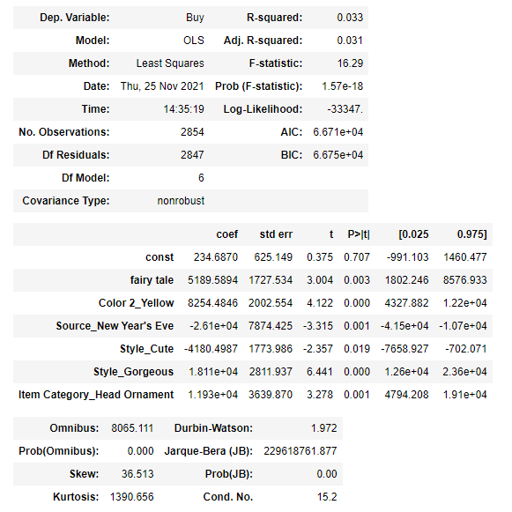
Modeling Buy Price
Some significant features found
Low explanatory power

Slide 14
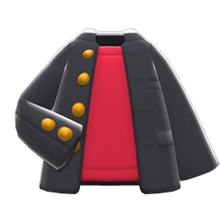
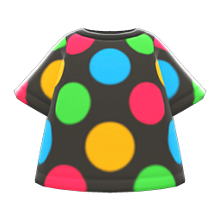
Dominant and Secondary Colors
After-School Jacket
Dominant Color: Black
Secondary Color: Red
Marble Dots Tee:
Dominant Color: Black
Secondary Color: Colorful

Slide 15
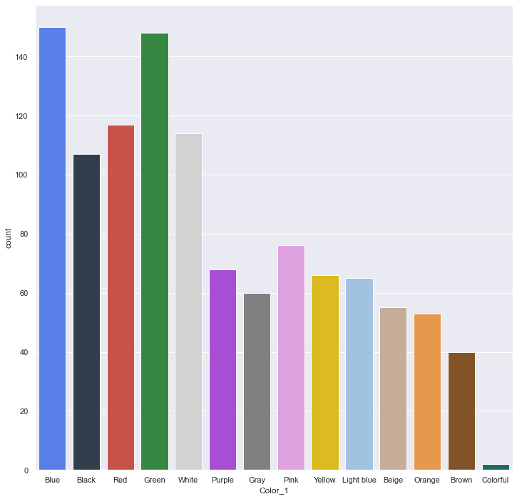
Most Common Primary Colors in Tops
There are 1,121 top variations
Blue and Green are the most common primary colors
Black, Red, and White are used around the same amount
Interesting to note that the Colorful color is almost nonexistent

Slide 16
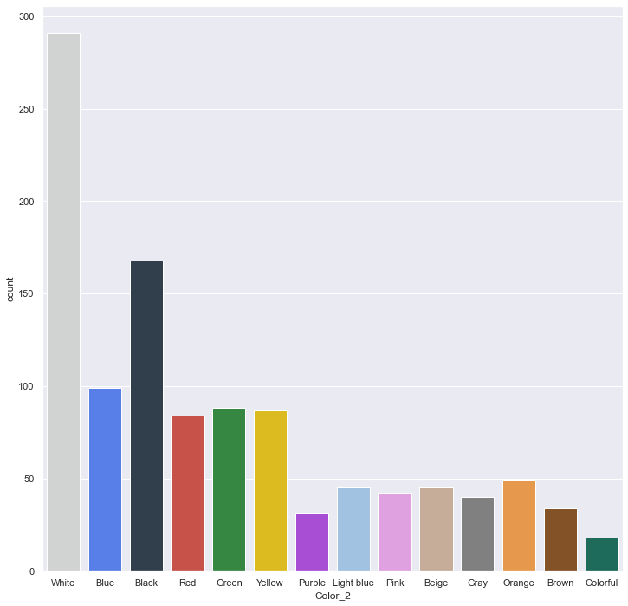
Most Common Secondary Colors in Tops
White is the most common secondary color
Black is the second most common secondary color
Other colors are generally used around the same amount as the secondary color

Slide 17
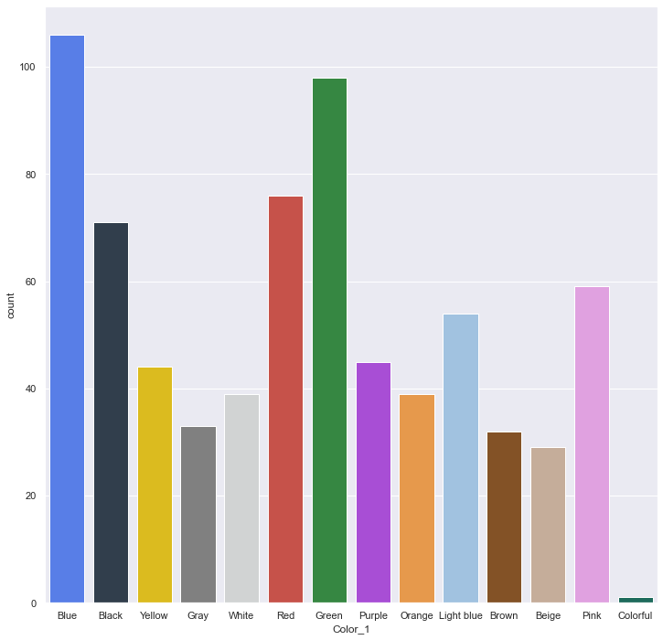
Most Common Primary Colors in Bottoms
There are 726 bottom variations
Blue is the most common primary color
Green is the second most common
The Colorful color is not often used as the primary color

Slide 18
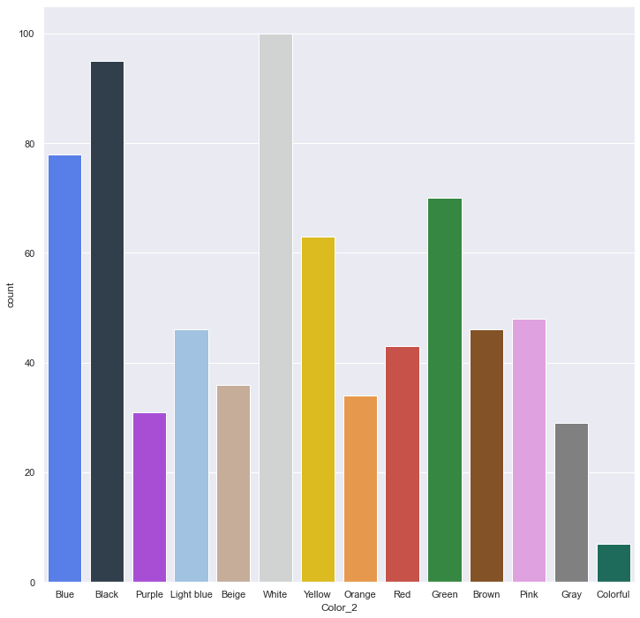
Most Common Secondary Colors in Bottoms
White and Black are the most common secondary colors
The Colorful color is not often used as the secondary color

Slide 19
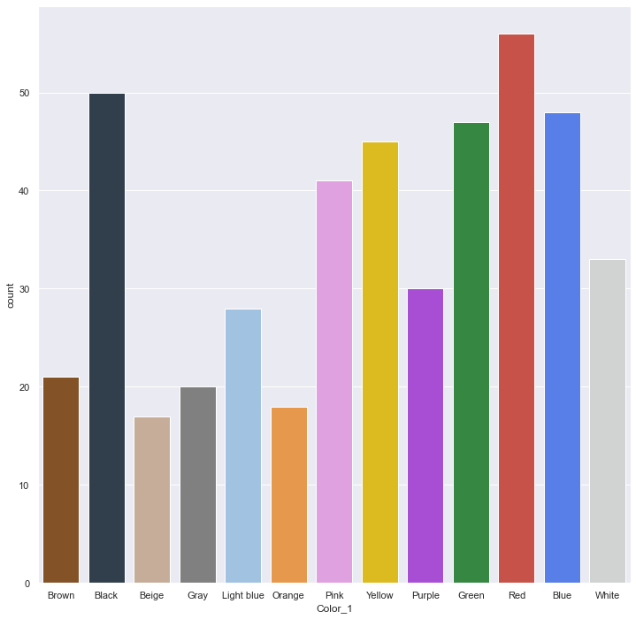
Most Common Primary Colors in Shoes
There are 454 shoe variations
Red is the most common primary color
Black, Blue, Green, Yellow, and Pink are often used at a similar rate
The Colorful color is not used in shoes

Slide 20
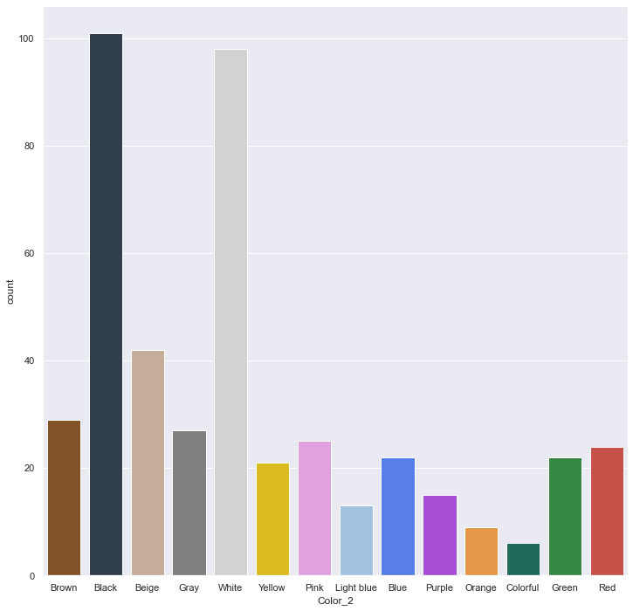
Most Common Secondary Colors in Shoes
Black and White are generally used as the secondary colors
The Colorful color is used as secondary color but not as a primary

Slide 21
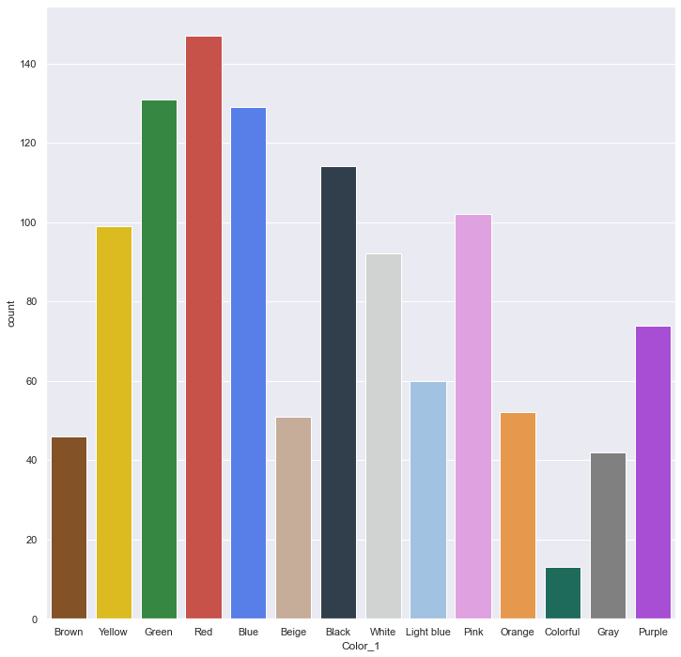
Most Common Primary Colors in Hats
There are 1152 hat variations
Red is the most common primary color
The distribution of colors is not skewed towards one or two colors

Slide 22
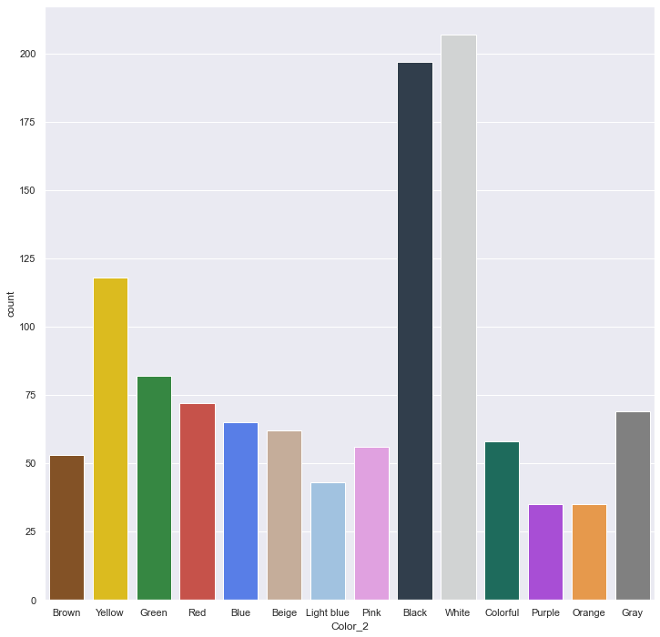
Most Common Secondary Colors in Hats
Black and White are commonly used as the secondary colors
The rest of the colors are used as a similar rate

Slide 23
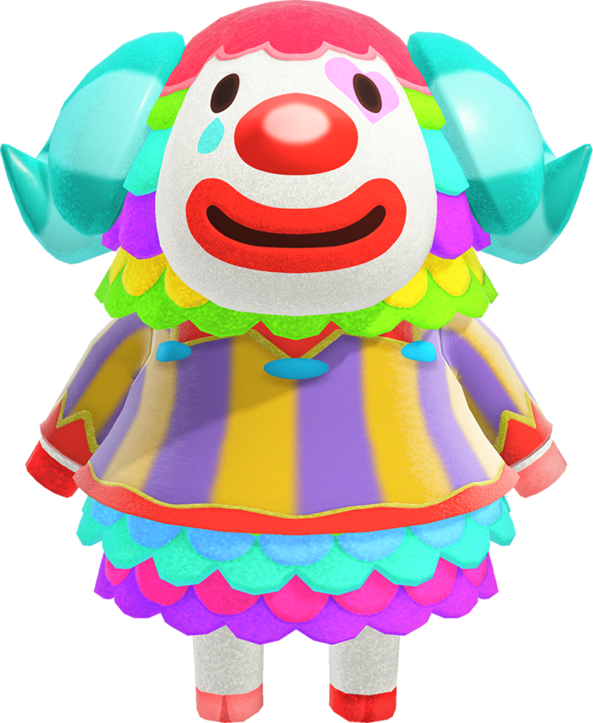
Summarizing Primary and Secondary Colors
Blue, Green, and Red are commonly used as the primary colors
Black and White are used a lot more than other colors as the secondary color
The Colorful color is rarely used as the primary color or secondary color

Slide 24
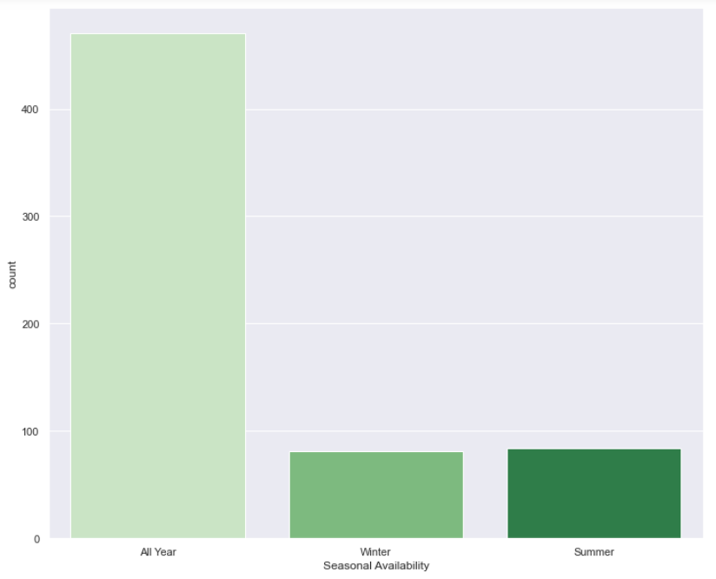
How Many Items are Seasonal?
Included seasons are Winter and Summer
More year-round items than seasonal items
More Summer than Winter
Under 100 seasonal items in each category
Over 400 items sold year-round

Slide 25

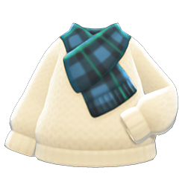
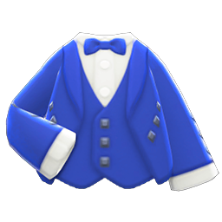
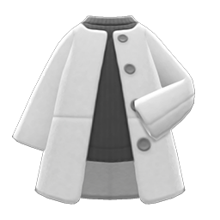
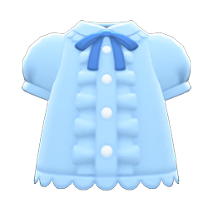
Further Analyzing Tops: Types
T-Shirts: Thinner shirt with no collar
Outer: Lower arms wider then cuffed
With or without scarves
Y-Shirts: Collared shirts
Used for dress shirts and other collared items
With or without long sleeves
Coat: Long outerwear with straight arms
Used for longer layered coats
Puff: Puffed sleeve shirts
A B C
D E

Slide 26
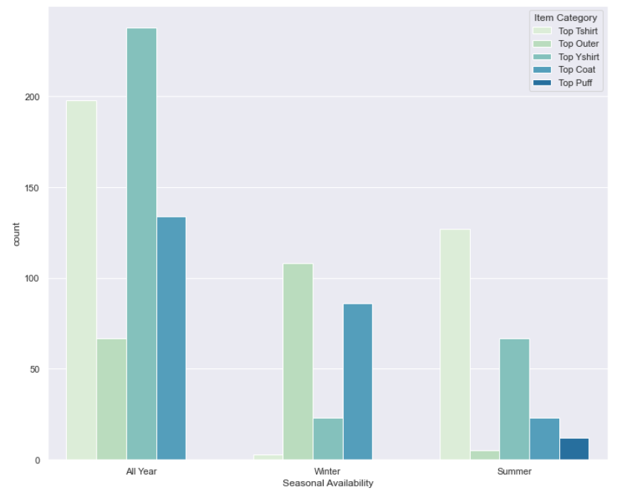
What Kinds of Tops are Seasonal?
Year-Round:
Y-shirt (collared shirts) most common
Puff least common
Winter:
Outer most common
Puff and T-shirts least common
Spring
T-shirts most common
Outer least common

Slide 27
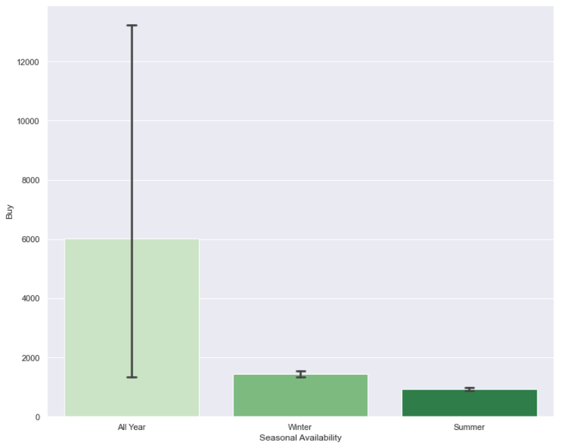
Average Prices for Seasonal Clothes
Year-round prices often higher and vary more
Year-round average prices highest
Winter has higher purchase prices than Summer

Slide 28

Average Resale Value for Seasonal Clothes
Year-round values usually higher
Vary more
Winter has higher resale value than summer
Overall much lower than purchase prices
Top purchase price is over 12,000 Bells while top resale value is 3,400 Bells
Top seasonal price is over 1,500 Bells while highest resale value is under 500 Bells

Slide 29
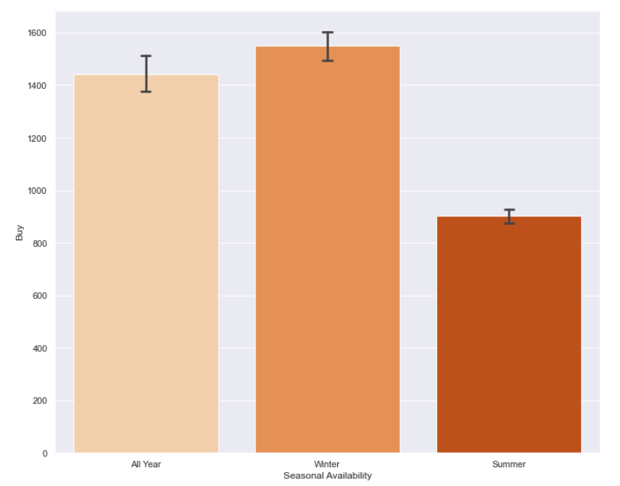
Average Prices for Seasonal Tops
Winter tops often sell for more than year-round tops
Summer top prices still the lowest
Year-round prices still most variable
Winter varies more in top prices than overall prices

Slide 30
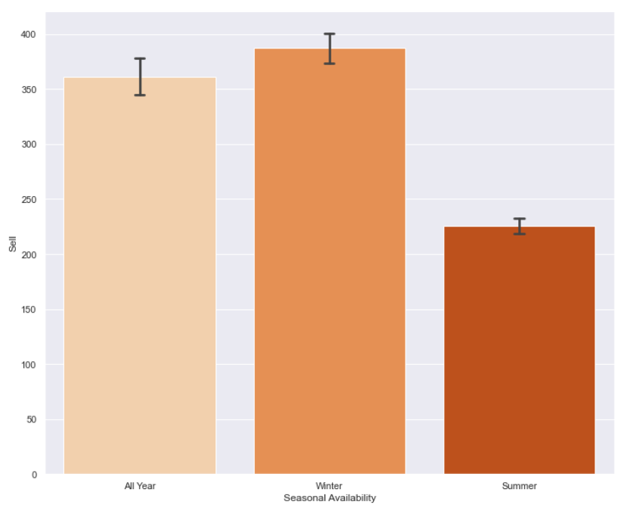
Average Resale Value for Seasonal Tops
Also higher resale value for Winter tops
Lowest value in Summer
Still most variation in Year-round prices

Slide 31
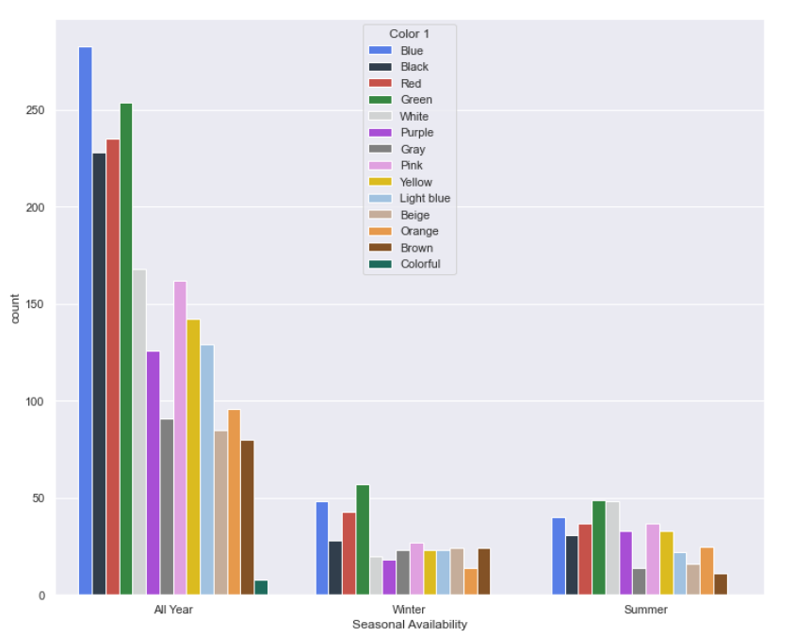
Most Dominant Colors in Seasonal Clothes
Year-round:
Blue most common
Colorful (rainbow) least common
Winter:
Green most common
Orange least common
Colorful not in the dataset
Summer:
Green most common
Brown least common
Colorful not in the dataset

Slide 32
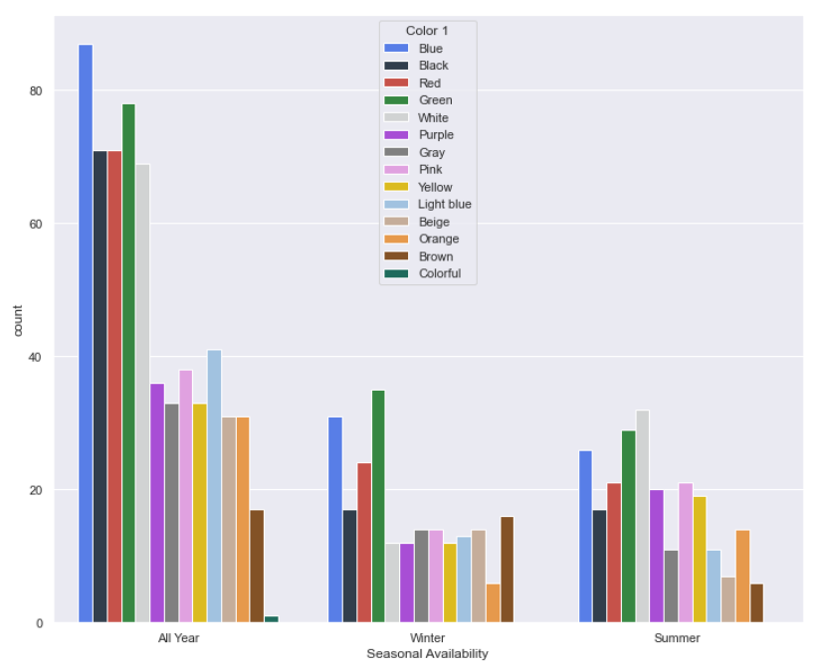
Most Dominant Colors in Seasonal Tops
Year-round:
Consistent
Blue most common
Colorful (rainbow) least common
Winter:
Consistent
Green most common
Orange least common
Colorful not in the dataset
Summer:
White most common
Brown least common
Colorful not in the dataset

Slide 33

Actionable Suggestions for Nintendo
Color suggestions:
Use secondary colors other than Black and White
Make more Colorful items overall
Price Suggestions:
Change from ubiquitous 25% resale price to more varied model
Give players higher sell prices for their items if they sell old items sooner to buy new items
Seasonal Considerations:
Create more seasonal items that aren’t tops
Seasonal items would be more exclusive with higher price/resale values
Make the dominant color (Green) different for overall seasonal clothes

Slide 34
Picture References
Able Sisters
Tom Nook Image
Bells Icon
Inside of Able Sisters Store
Buying from Kicks
Shirts: T-Shirt, Y-Shirt, Outer, Puff, Coat
Single Characters: Timmy and Tommy, Kicks, Label, Isabelle, Pietro
Most Expensive Outfit: Royal Crown, Royal Shirt, Samurai Shirt, Noble Pants, Samurai Greaves, Space Boots, Zori
Least Expensive Outfit: Paper Bag, Tank, Athletic Shorts, Traditional Suteteko Pants, Flip-Flops, Slip-On School Shoes, Restroom Slippers, Shower Sandals, Slippers
Color Examples: After School Jacket, Marble Dots Tee
Person with Switch

Slide 35
References
Bell Conversions:
New Leaf Yen Conversion
New Horizons
Updated Conversion Rate as of 11/16/2021
Clothing Background Information:
Categories and Colors

